Slide 1
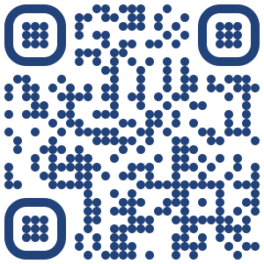
My Time at Moffitt
Adam Wojtulewski
Moffitt Cancer Center
Machine Learning Department
Karolak Lab

Slide 2
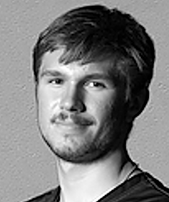
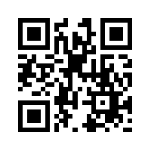
About me
Adam Wojtulewski
Completed International Baccalaureate (IB) Program at Palm Harbor University High School in May 2021
Third year undergraduate at the University of Florida (UF); complete Bachelor’s Degree in December 2024
Enrolled in Combination Degree at UF; complete Master’s Degree in December 2025
Major in Computer Science and Minor in Artificial Intelligence
President of the Polish Student Association (POLSA) at UF
Took this internship opportunity to have a hands-on application of machine learning approaches
LinkedIn QR Code

Slide 3
Phase 1: JupyterLab Work (Summer 23)
The goal of this study was to take the first step and understand the variability in response using public sequencing data.

Slide 4
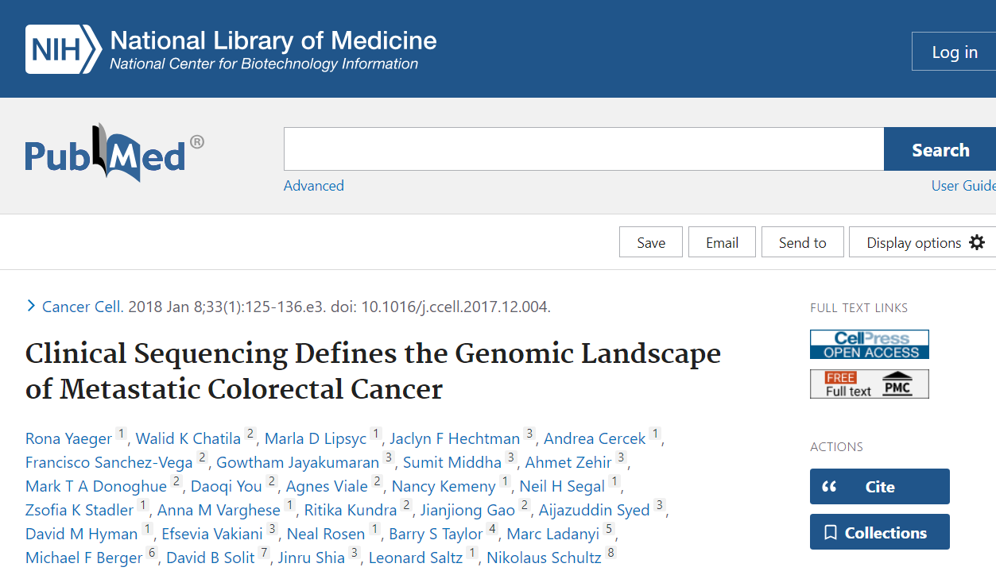
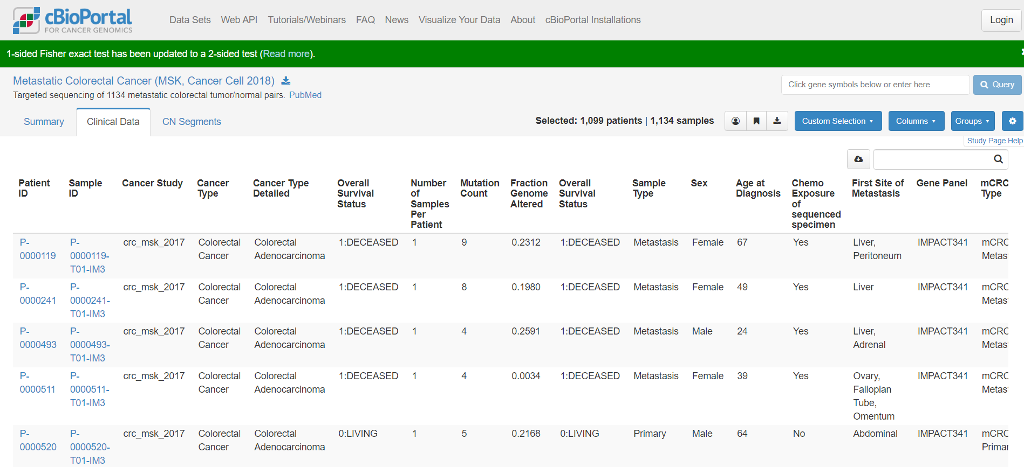
Datasets

Slide 5
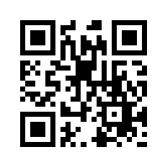

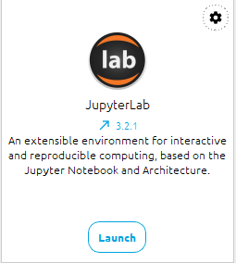
Running my code
Integrated Development Environment (IDE)
Github QR Code
https://www.anaconda.com/download/
https://github.com/AdamWojtul28/Moffitt-Data-Analysis

Slide 6
Steps
Data Pre-processing
Data visualization
K-Means Clustering
Random Forest Classifier
Artificial Neural Networks
Model verification

Slide 7
Results from average accuracy functions
Average Percent Accuracy of RF Models
Average Percent Accuracy of ANN Models
Percentage Correct Predictions (after 25 iterations)
ANN Architecture | W/o Drug Info | W Drug Info
2 - 1 | 0.5206 | 0.7355
4 – 1 | 0.5162 | 0.7627
8 – 1 | 0.5168 | 0.7527
16 – 1 | 0.5054 | 0.7333
32 – 1 | 0.4978 | 0.7314
64 – 1 | 0.4946 | 0.7219
128 – 1 | 0.5000 | 0.7249
3 – 3 – 1 | 0.5105 | 0.7135
3 – 5 – 1 | 0.5156 | 0.7208
3 – 7 – 1 | 0.5162 | 0.7178
3 – 9 – 1 | 0.5217 | 0.7107
3 – 11 – 1 | 0.5130 | 0.7064
Without drug info: 58-84%
With drug info: 74-77%
Verdict:
The latter’s consistency makes it the superior model upon first glance

Slide 8
Results from feature importance calculations
Rank | Column Name | Percent Importance
1 | Survival Date of mets to date of death or last FU for mCRC (months) | 0.064767
2 | Time from Met Dx to Sequencing | 0.060251
3 | Average Sample Alele Frequency | 0.049957
4 | Fraction of Genome Altered | 0.049921
5 | Age at Diagnosis | 0.044515
6 | MSIsensor Score | 0.044153
7 | Metastasectomy | 0.0431
8 | Mutation Rate (mut/mb) | 0.03874
9 | Ratio of Indel to Substitutions | 0.037599
10 | MSK IMPACT PANEL_IMPACT341 | 0.019471

Slide 9
Phase 2: Oktoberfest Poster (Fall Semester)
The goal was to provide the justification for the work that I had already done; specifically to demonstrate that there was variability based on the dataset I had previously used.

Slide 10
Steps
Clean up data from summer work
Remove correlated terms
Find most clinically significant and display them in a bar graph
Create multiplots based on patient characteristics, dividing the total number of patients considered into subgroups every time

Slide 11
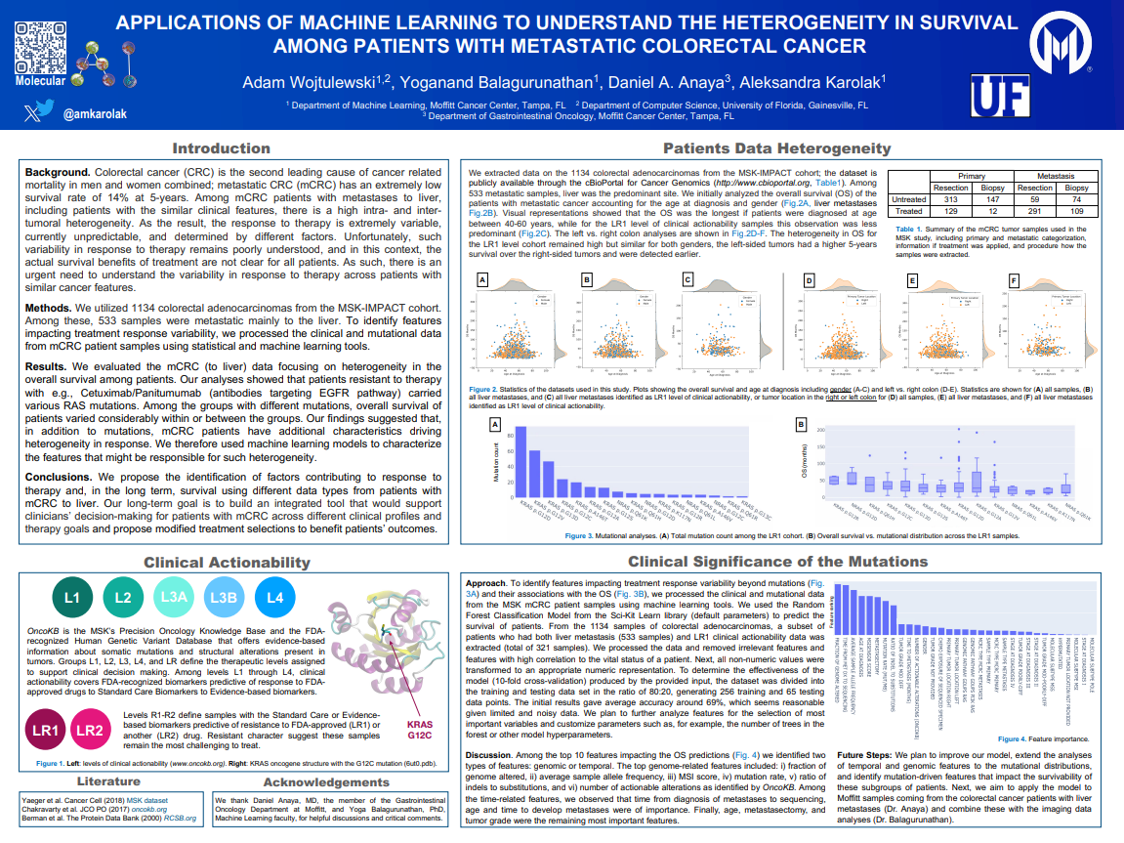

Slide 12
Phase 3: AI Methods Review Article (Spring Semester)
The aim is to explore the applications of different artificial intelligence and statistical approaches towards the analyses of peritoneal metastases resulting from gastrointestinal cancers.

Slide 13
Steps
Go over past work done by Ola Sikora and Professor Karolak
Perform literature search to find relevant articles
Stored key information in an Excel Document
Write introduction and methodology
Create title and abstract
Summarize articles
Make conclusions based on findings

Slide 14
Example Analysis Paragraph
To begin, Schnelldorfer et al applied convolution neural networks (CNN) to differentiate peritoneal metastases from other types of peritoneal lesions, using laparoscopic images of 87 consecutive peritoneal lesions to train their model6. They predicted that despite the availability of imaging data containing peritoneal lesions, a significant majority of peritoneal lesions remain misidentified. While the study identified that many of incorrect diagnoses were due to incorrectly identifying a lesion as metastatic, they still noticed that a significant number of metastases is missed by their visual appearance alone, suggesting the consideration of alternative approaches like DL. The developed model reached a good AUC of 0.82, much better than the AUC of the ML neural network trained with tenfold cross-validation, with an AUC of only 0.47 (Table 1). With the model, the group identified that degree of nodularity, border transition, and degree of transparency were independent predictors of MS.

Slide 15
Future Plans
Academic
Complete Bachelor’s Degree in December 2024
Complete Master’s Degree in December 2025
Get re-elected as president of POLSA and build upon successes from this year in POLSA
Complete more NVIDIA certificates
Professional
Currently looking for an internship (in Poland)
Do plenty of Leetcode and CodeSignal questions in my free time to prepare

Slide 16
Thank you
Github QR Code
LinkedIn QR Code
Questions?

